Slide 1
Welcome Back!
Don’t forget to take a tissue to wipe down your desk…
Please do not sit at desks with boards.

Slide 2
IB English Language and Literature
6 ELL SL 4
2019 - 2020
Shape of the Week (1):
Lesson 1: Paper 1 Revision
Lesson 2: Paper 1 Revision – Putting it together
Lesson 3: Paper 1 Revision Peer Marking

Slide 3


SCHOOL ASSESSMENT TERM 4
☑ NOTHING!

Slide 4


Slide 5
General Outline Term 4
Week 1: 14th-18th September
Lesson 1: Recap ‘Big 5’ and Text Types.
Lesson 2: Planning, paper 1 structure and annotation of example. Complete past paper (HW).
Lesson 3: Marking peer exam paper 1 and go through the mark schemes.
Week 2: 21-25th September
Lesson 1: Revision of main ideas/themes/issues presented in ‘1984’.
Lesson 2: Revision of main ideas/themes/issues presented in ‘COADF’.
Lesson 3: Structure and planning for paper 2. Complete exam questions (HW).

Slide 6
General Outline Term 4
Week 3: 28th Sep- 2nd October
Lesson 1: Marking peer exam paper 2 and go through the mark schemes.
Lesson 2: Exam questions spreadsheet and planning (shared doc).
Lesson 3: Exam questions spreadsheet and planning (shared doc).
Week 4: 5th-9th October
Lesson 1: Final Paper 1 + 2 Revision

Slide 7



We are still a digital classroom!

Slide 8
Review yesterday’s plannning

Slide 9

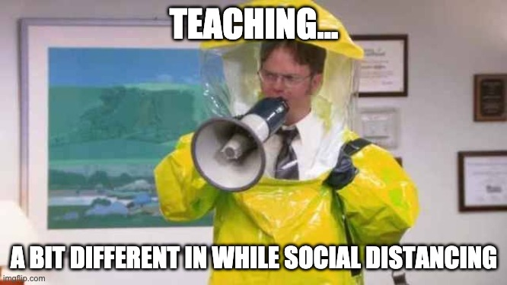
‘Tis the Season… for Surveys! https://acs.fireflycloud.asia/students-survey-of-teachers/english-2020-

Slide 10

But First!

Slide 11

Paper 1 SL Beach Sweatshirt and Practice Paper 1 Shape
Complete the Practice Paper 1 Shape Activities.
Use the other resources to review and guide you. You could also look on Managebac!
Hand in the worksheet Practice Paper 1 Shape to Firefly by 13.35. We will review your response on the board.

Slide 12
Planning, paper 1 structure and annotation of example.

Slide 13
In pairs…
Go to today’s task on Firefly. Open Structural Options for Paper One.
Will be assigned either structural option 1 (black) or 3 (white).
Use your post-its to write ideas for planning each section. Put your post-its in the correct section.

Slide 14
MARKING: Read the Paper 1 text/ questions, exemplars

Slide 15
L&L P1 SL Student _______________________________ DP English Language and Literature A1 SL Assessment Criteria for Paper 1: Textual Analysis
Criterion A: Understanding of the text |  | Criterion B: Understanding of the use and effects of stylistic features |  | Criterion C: Organization and development |  | Criterion D: Language
5 | There is very good understanding of the text and context; perceptive comments are supported by consistently well-chosen references to the text. | 5 | There is very good awareness of the use of stylistic features, with good understanding of their effects. | 5 | The analysis is effectively organized and coherent. The argument is well developed. | 5 | Language is very clear, effective, carefully chosen and precise, with a high degree of accuracy in grammar, vocabulary and sentence construction; register and style are effective and appropriate to the task.
4 | There is good understanding of the text and context; comments are consistently supported by references to the text. | 4 | There is good awareness of the use of stylistic features, with adequate understanding of their effects. | 4 | The analysis is well organized and mostly coherent. The argument is adequately developed. | 4 | Language is clear and carefully chosen, with a good degree of accuracy in grammar, vocabulary and sentence construction; register and style are consistently appropriate to the task.
3 | There is adequate understanding of the text and context; comments are mostly supported by references to the text. | 3 | There is adequate awareness of the use of stylistic features, with some understanding of their effects. | 3 | The analysis is adequately organized in a generally coherent manner. There is some development of the argument. | 3 | Language is clear and carefully chosen with an adequate degree of accuracy in grammar, vocabulary and sentence construction despite some lapses; register and style are mostly appropriate to the task.
2 | There is some understanding of the text and context; comments are sometimes supported by references to the text. | 2 | There is some awareness and understanding of stylistic features. | 2 | Some organization is apparent; the analysis has some coherence but may contain elements of paraphrase, summary and simple explanation. There is little development of the argument. | 2 | Language is sometimes clear and carefully chosen; grammar, vocabulary and sentence construction are fairly accurate, although errors and inconsistencies are apparent; the register and style are to some extent appropriate to the task.
1 | There is little understanding of the text and context; comments are not supported by references to the text. | 1 | There is little awareness or understanding of the use of stylistic features. | 1 | Little organization is apparent, with reliance on paraphrase and summary rather than analysis. | 1 | Language is rarely clear and appropriate; there are many errors in grammar, vocabulary and sentence construction and little sense of register and style.
0 | Level 1 is not achieved | 0 | Level 1 is not achieved | 0 | Level 1 not achieved | 0 | Level 1 is not achieved

Slide 16

Homework
Complete the Commentary – on Hard-copy on FOOLSCAP, under timed conditions if possible.
It needs to be hard copy because we will peer mark.

